Slide 1

interfaces
Dr.A.menaka Pushpa, scope, vit, chennai

Slide 2
interface
Mechanism to achieve abstraction.
There can be only abstract methods in the Java interface, not method body.
Used to achieve abstraction and multiple inheritance.
we can have default, static and private methods in an interface.

Slide 3
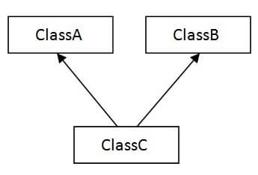
Multiple inheritance

Slide 4
Similar to Class
Can’t create an object for Interface
Other classes can implement an Interface
Default – Access only within the Package
Public – Access can be outside of the Package

Slide 5
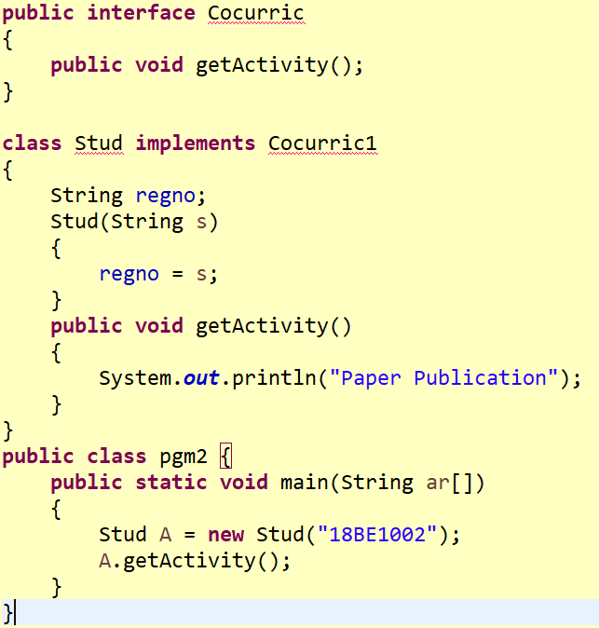

Slide 6
Output
Paper Publication

Slide 7
Keywords?
interface
Implements

Slide 8
Multiple inheritance - interface
Extracurricular Activity
Cocurricular Activity
Student

Slide 9
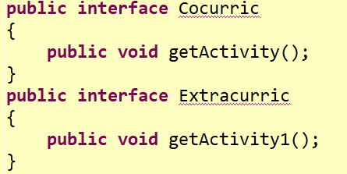

Slide 10
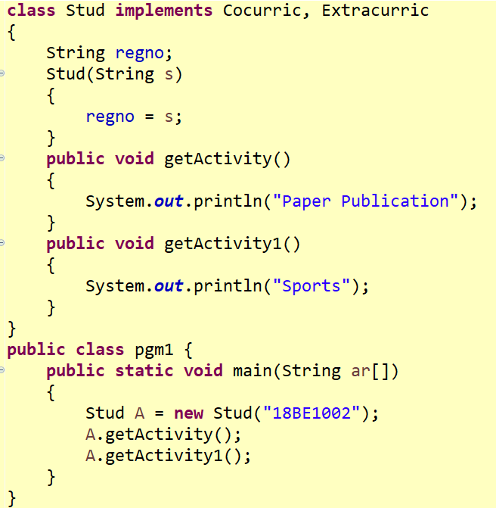

Slide 11
output
Paper Publication
Sports

Slide 12
Students Task
Create an Abstract class ‘Animal’ – Method HowtoSound()
Create an Interface ‘Edible’ with howtoeat/howtocook()
Create a Class for Rice and Orange
Create a separate Test Class with main()

Slide 13
Students Task
Create an interface for Mother – any method
Create an interface for Father – any method
Create a class for child that implements Father and Mother
Create an test class with main method

